Slide 1
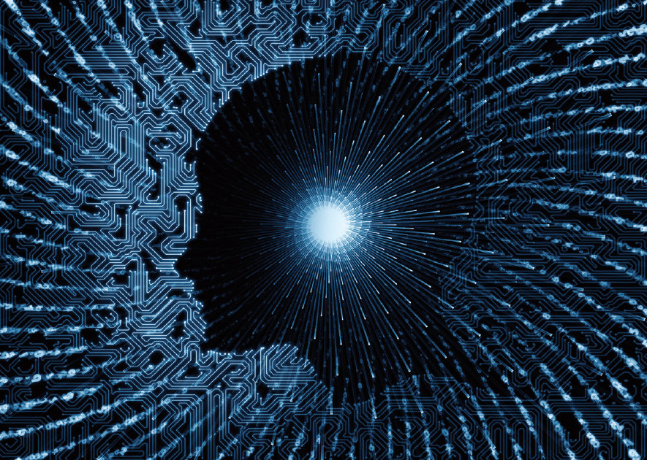
I- EGO
19조 이예지 손승범 곽민제

Slide 2
Contents
01 Project Motivation
02 Overview of I-EGO project / application
03 Implementation
04 Result
05 Marketing Plan
Notes:
-> 발표는 이러한 순서로 진행하겠습니다.

Slide 3

I-EGO project and App
Classifies sensibility(arousal, valence) using EEG brain waves.
I-EGO Project
Figure out user's personality while they are watching videos with VR device based on I-EGO project.
I-EGO Application

Slide 4

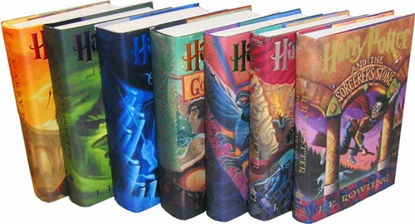


Motivation
Writing
Video
-Takes a long time to read
-Has a restriction to specify

Slide 5
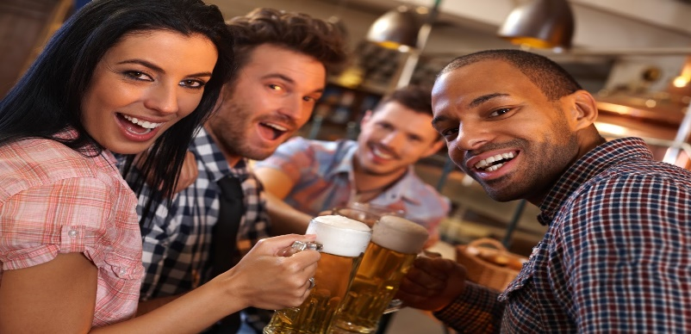
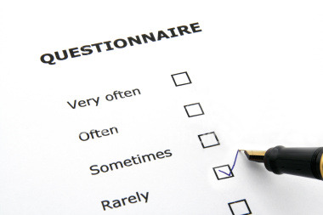
“我- EGO (I-EGO) ”
“Useful personality test application based on brainwave by watching VR video instead of text-based marking”
Instead

Slide 6
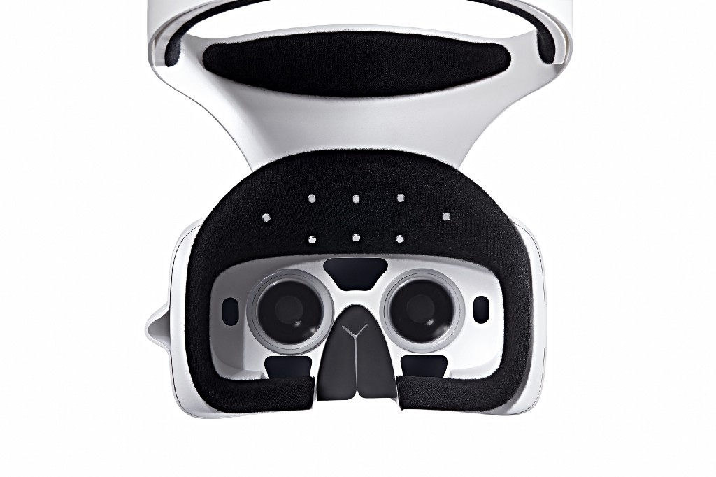
Used VR device
“Brain waves VR headset”
-With six brain waves of electrode sensors. -Easily measure brain activity is wearing a headset.

Slide 7
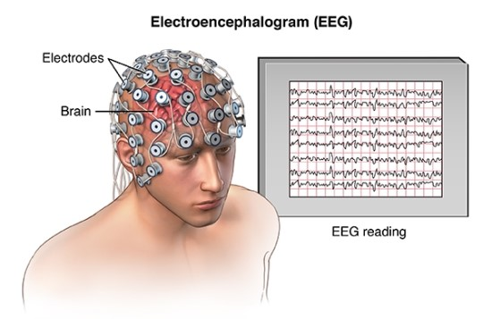
Advantage of brainwave VR device
No need to extra brain wave measurement

Slide 8
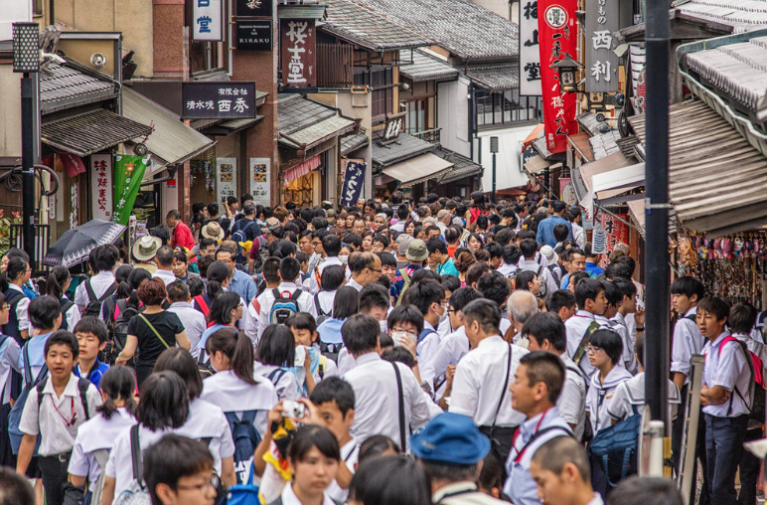

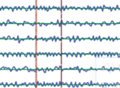
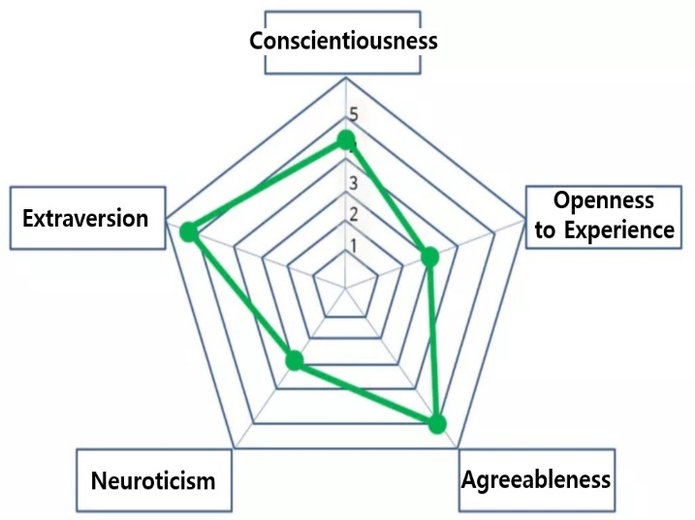
How it works animation
4
Q1
Q2
2
4
5
Preference
Classifier
Q3
Q4
3
Q5
5
Q6
1

Slide 9
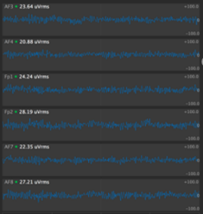
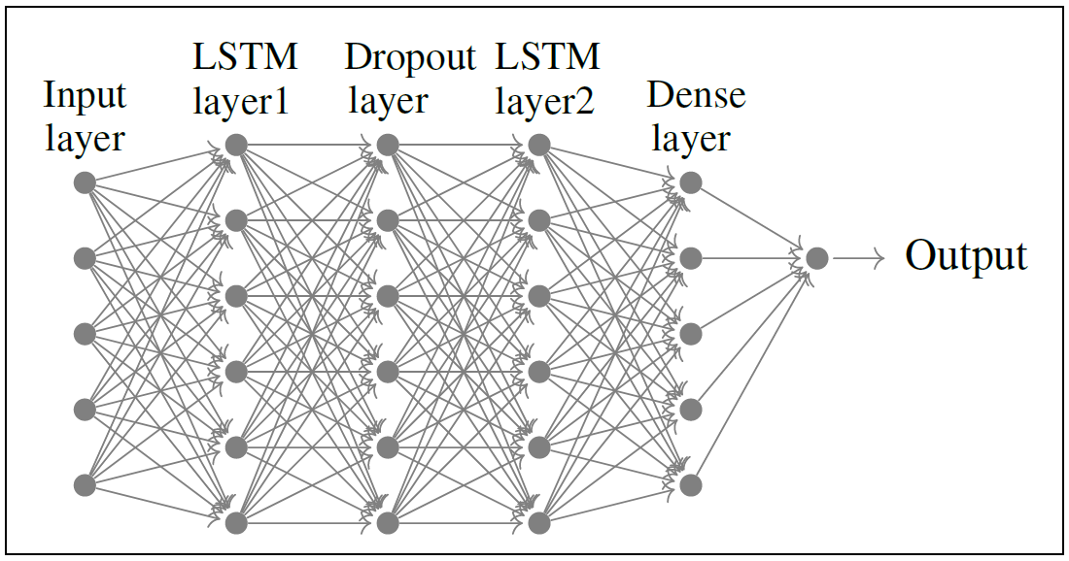
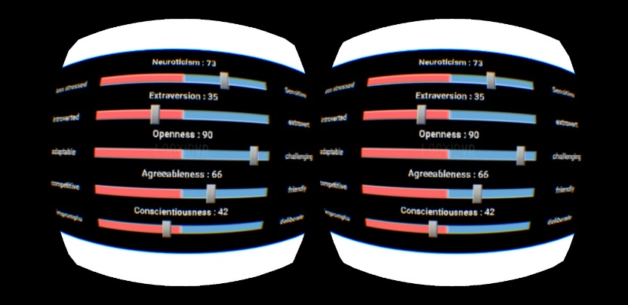
Structure
Play & Extract
Analysis Part
Output Part
The first part is where play the VR images and extract the brainwaves,
Classify input data
to preference
Show result of
personality analysis

Slide 10
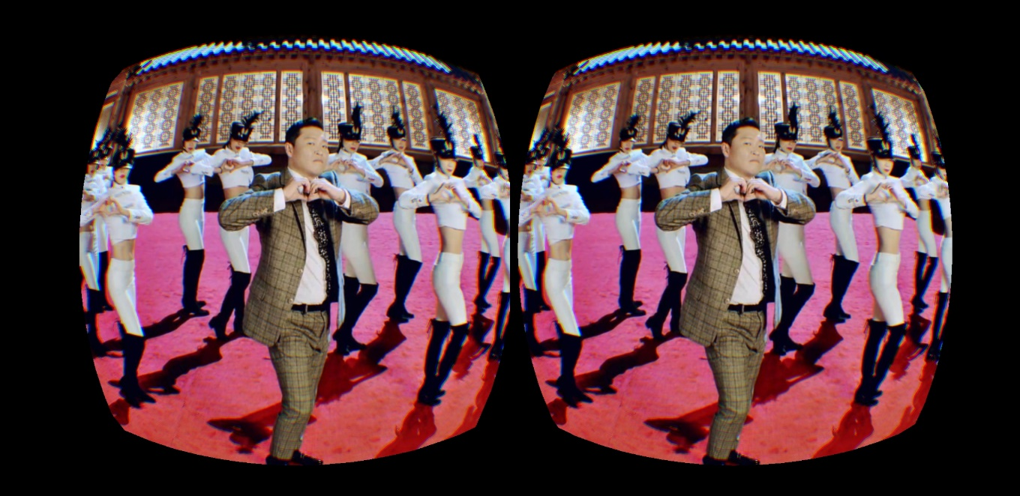
Play & Extract Part
<Mobile VR Application>
-User watch a video that represents the personal characteristics.
(Video is one minute)

Slide 11
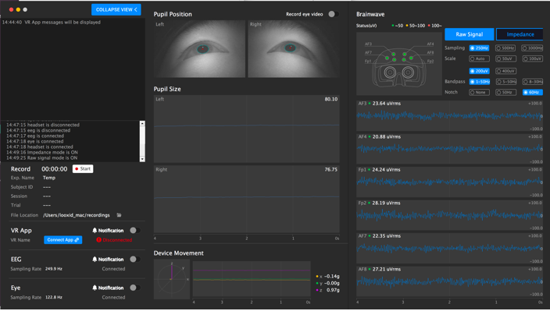
Play & Extract Part
<LooxidVR APP on PC>
EEG data
- Collects brain waves in real time during video viewing. (CSV file format)

Slide 12
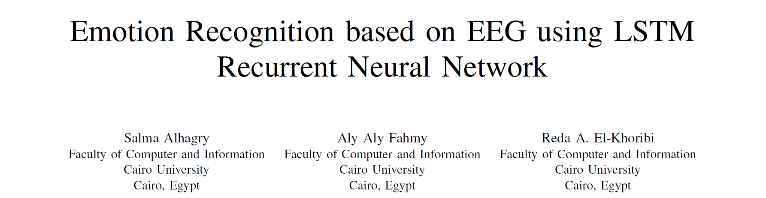
Analysis Part
This reference presents a binary classification of EEG signal data for emotion recognition.
Suggested model has 2 LSTM layers and
using DEAP dataset for training.
We make a model referenced by this and DEAP data set
What is DEAP dataset?
DEAP dataset contains
Participants’ EEG signal data
Participants’ emotion
as each participant watch 40 one-minute videos.

Slide 13
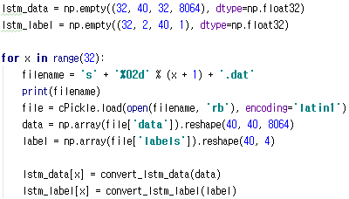
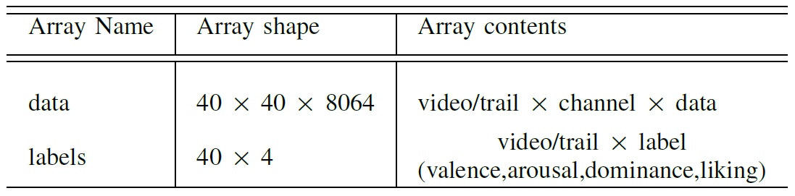
Analysis Part
[Original Data]
[Reconstruction]
But original input data per each video consists of 2 dimensions.
So, we have to reconstruct original data to apply in LSTM model.

Slide 14
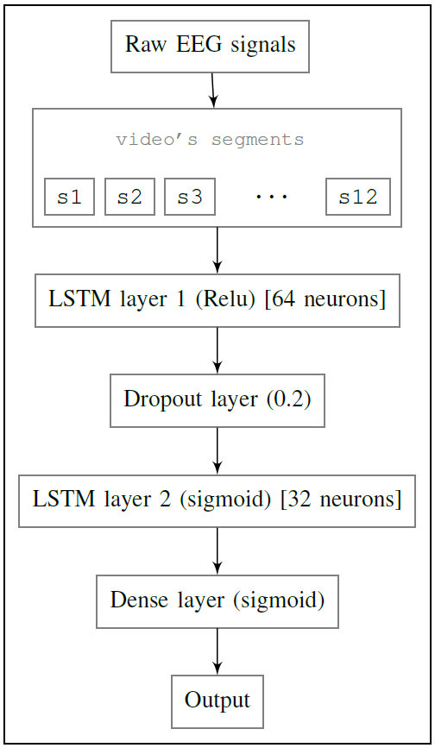
Analysis Part
LSTM model consists of the following layer configuration.
Each participant data consists of 8064 readings for channels for each video.
It segmented into 12 segments.
This model implemented by using Keras.

Slide 15
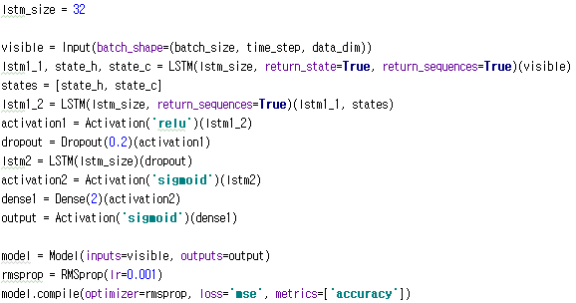
Analysis Part
Following layer configuration in previous page,
But there was very low accuracy.
So, we went on learning model by changing parameters and hyper parameters.

Slide 16
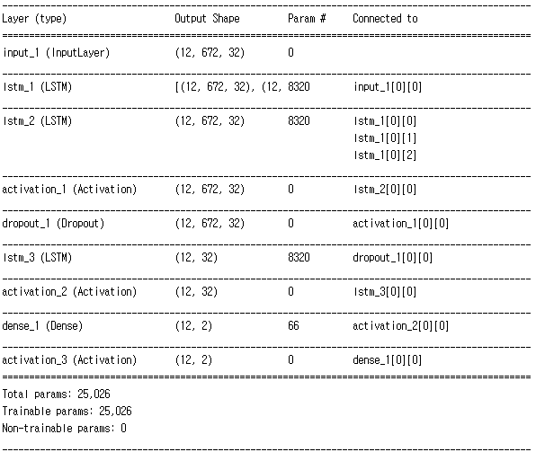
Analysis Part - Result
LSTM model finally has
12 x 672 x 32(3-d) input.
And all layers are correctly implemented by according to the thesis.
→

Slide 17
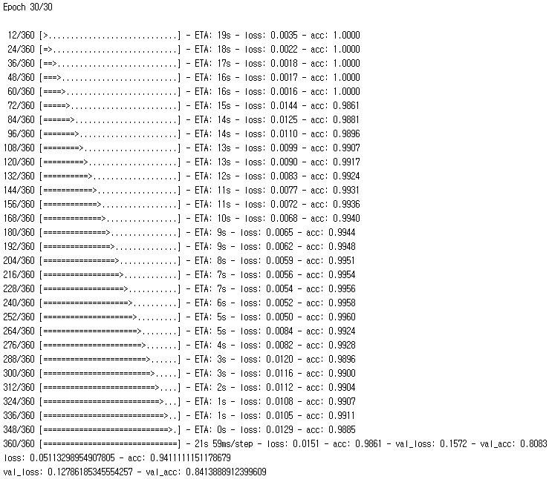
Analysis Part - Result
Model shows high validation accuracy.
It can be used in our application!

Slide 18
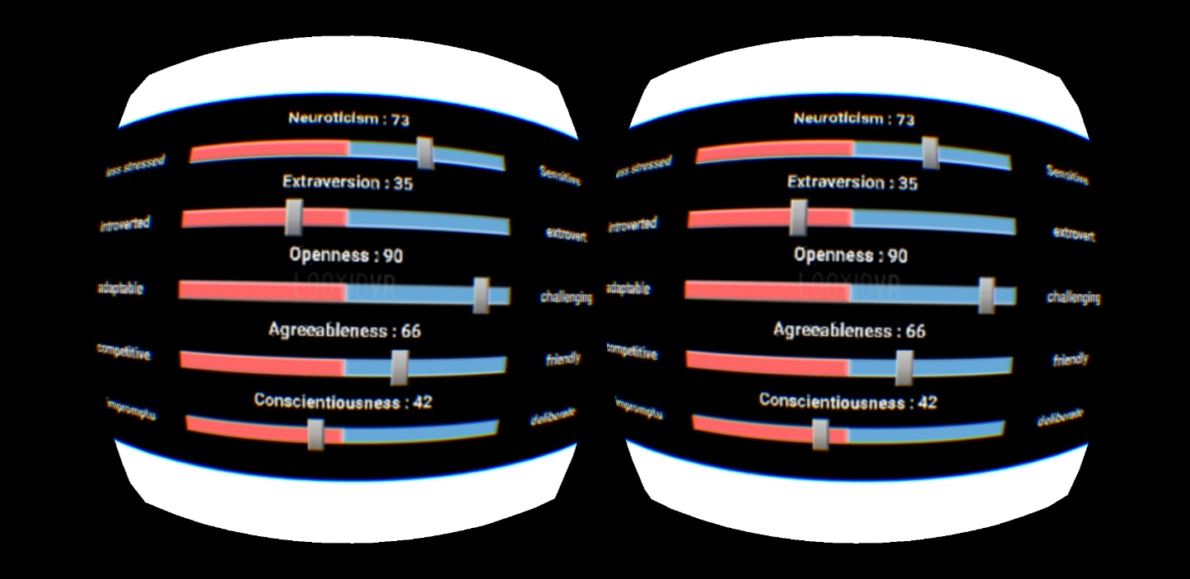
Output part
This 5 indicator is a personality analysis indicator called Big5.
1. Neuroticism :
Less stressed ↔ Sensitive
2. Extraversion :
Introverted ↔ Extroverted
3. Openness :
Suitable ↔Challenging
4. Agreeableness :
Competitive ↔ Friendly
5. Conscientiousness :
Immediate ↔ Planning
< Mobile VR App >

Slide 19




Marketing plan - SWOT
S
STRENGTHS
WEAKNESSES
W
Classifying personality just by watching videos.
Analyzing user’s real thoughts.
Each user must have own device(HMD).
Lack of initial data.
O
OPPORTUNITIES
THREATS
T
Research using brain waves is active.
VR market have not been activated until now.

Slide 20

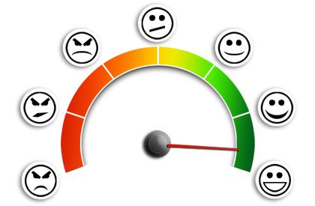
Marketing plan - Target
[Study on Concentration]
[Emotional analysis]
It can be used in a variety of fields
by using real emotions that are not apparent

Slide 21
Marketing plan – Expected Value
Set a fee for each number of times user uses contents.
Data from each user will accumulate and it can be used in learning that shows more accuracy.

Slide 22
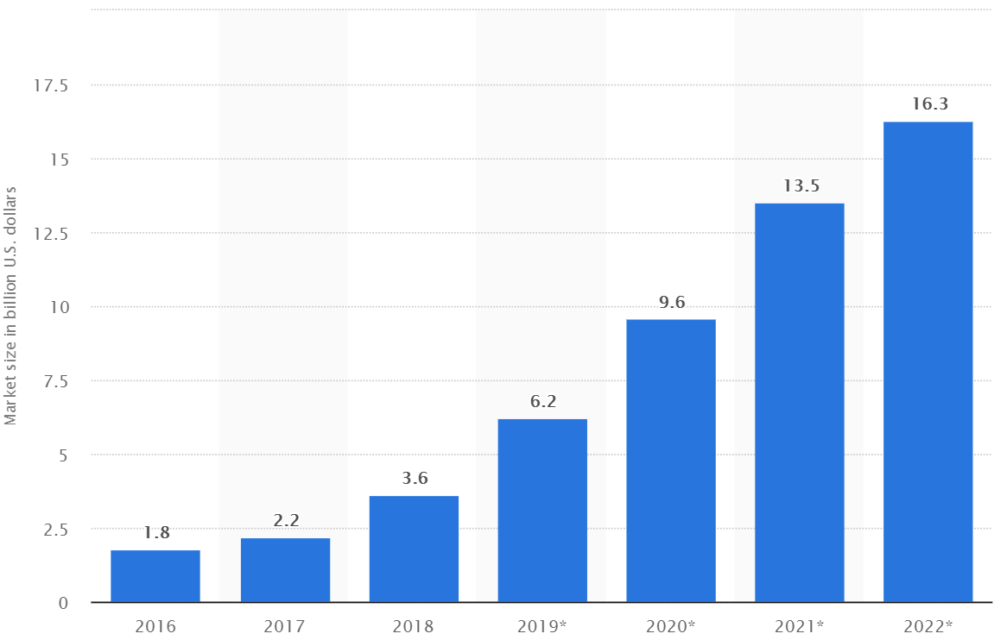
Marketing plan
Consumer virtual reality software and hardware market size worldwide from 2016 to 2022 (in billion U.S. dollars)
VR market will grow faster in the future.
So, our users will also increase further.
Statistia, 2019

Slide 23
Git address
https://github.com/I-EGO/I-EGO/wiki

